Slide 1
Zoom Instruction for HSJ59 For speakers & audiences
HSJ59 Organization Committee
Based on https://redbuller.hatenablog.com/entry/2020/03/28/022605 (CC BY 4.0) 2020-12-01

Slide 2
Installation of Zoom
Download and install zoom app, and sign-up your zoom account, if you have not yet installed it in your computer.
Website:
https://zoom.us/download#client_4meeting
Set up microphone, speaker, and camera for Zoom prior to HSJ59 meeting.
Notes:
参考URL：https://zoom-japan.net/manual/pc/zoom-pc-app/

Slide 3
Update your Zoom
Please use the latest version of Zoom
Click / Tap the icon
Click “Check for Updates”
If your zoom is not the latest version,
update will be automatically started.

Slide 4
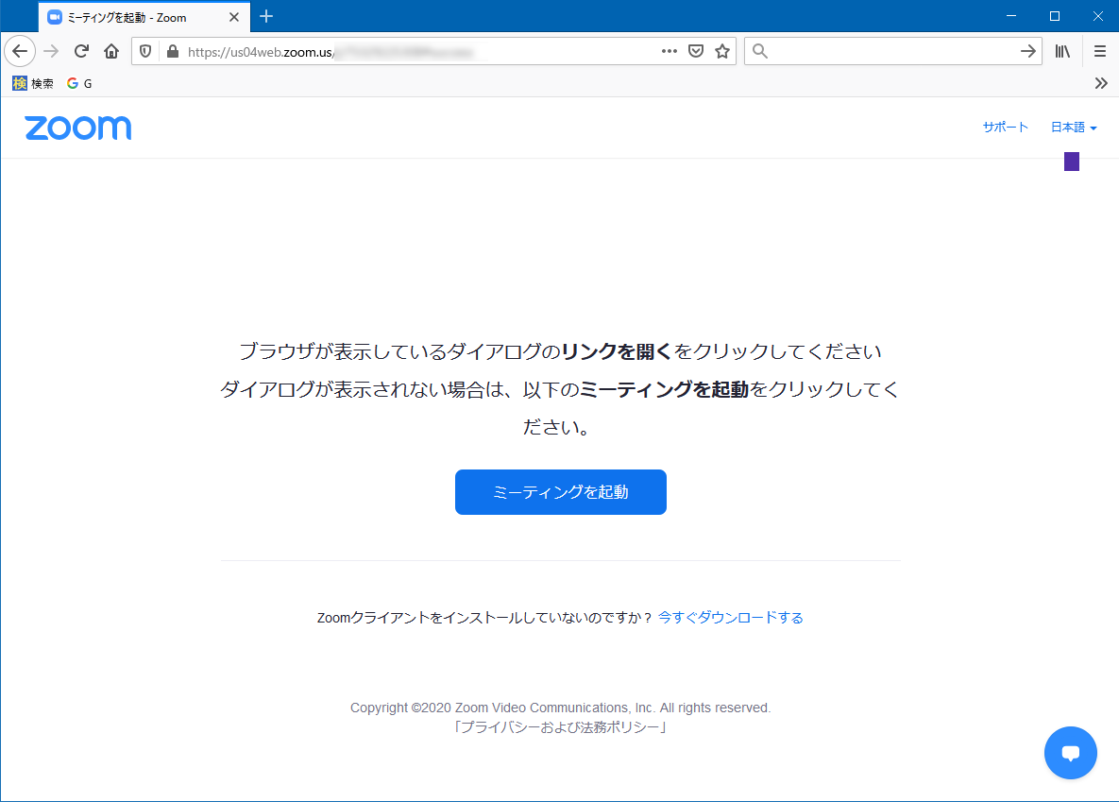
Entering the meeting room
Access to the URL for oral presentation / business meeting
Zoom room
Example URL:
https://us04web.zoom.us/j/01234567890
* The correct URL will be informed to the participants later
Input the passcode.
The passcode will be informed only to the participants
①
①Input the passcode
②Click/tap “Join Meeting”
②

Slide 5
Preparation for speakers and audiences

Slide 6
Rename
Please rename your zoom handle name as below
You can rename your handle name after sign-in.
Oral speakers should presentation number (ex. “O-35”) at the beginning of the handle name, in the session with your own oral presentation
[Your name]_[Your Affiliation]
How to rename
Call the participants list
Mouseover yourself, click “More,” and “Rename”
In your oral presentation: O-35HanakoKyoto_KyotoUniv
Other sessions: HanakoKyoto_KyotoUniv.

Slide 7
Microphone and camera
Please turn off your microphone and camera when you are an audience.
When you make a question (after selected by the chair of the session), unmute yourself. Also you can turn on your camera.

Slide 8
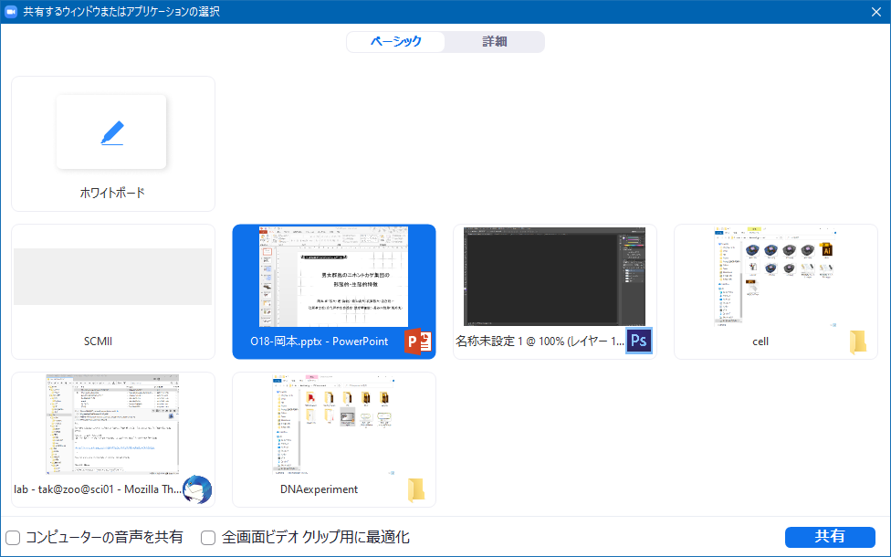
Share screen
Oral speakers can show their own slides by “Share Screen”
Beginning of your talk：
①Click/tap “Share Screen”
②Select your powerpoint window
③Click/tap “Share” at the right bottom
End of your talk：
④Click/tap “Stop Share”
①
②
③
④

Slide 9
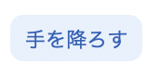
“Raise Hand” for Q&A
When you have a question on Q&A after each oral presentation, please use “Raise Hand.” When the chair select you , you can unmute (the chair will permit your unmute) and tell your question.
“Raise Hand”
Click “Raise Hand” at the bottom of the participants list.
Then a hand icon will be appear beside your name.
You can stop raising your hand by “Lower Hand”
質疑応答の進め方の参考元：日本教育工学会2020年春季大会・大会実行委員会（信州大学）
Notes:
JSETのやり方を参考にしました

Slide 10
Chat
You can make a question by chat, when your microphone does not work. Input your question by chat “To Everyone” after “Raise Hand” and selected by the chair, then the chair will read the question.

Slide 11
How to leave
Leave
You can leave the meeting by clicking/tapping “Leave” icon
You can enter the meeting room again by accessing the URL and input the passcode.

Slide 12
Instruction for oral speakers
On your own presentation, unmute yourself and turn off your camera. You can turn on your camera on Q&A.
Rename your name in your session： [Presentation number] [Name]_[Affiliation] (ex, O-31HanakoKyoto_KyotoUniv)
Unmute your self (the chair will permit your unmute), “Share” your slide, and start
Q&A is after your presentation. Please often your chat window.
After your presentation and Q&A, rename yourself as [Name]_[Affiliation]
Presentation: 12 min and Q&A 2.5 min.
(参考元)日本教育工学会2020年春季大会・大会実行委員会（信州大学）「学会全国大会のオンラインでの試行開催の運用メモ」；情報処理学会第82回全国大会「情報処理学会 大会／研究会 Zoom接続の手引き 」

Slide 13
Instruction for audiences
１．Mute yourself and turn off your camera
２．Rename your self as [Name]_[Affiliation]
３．Q&A
Person who want to make a question (you): “Raise Hand”
Chair: Ocassionally assign you as the Questioner, and permit your unmute.
Questioner: Unmute yourself and make a question. If your microphone does not work, you can make a question by chat. After your Q&A, mute your self again.

